Slide 1
Introduction to Kafka

Slide 2

Who Am I?
Petter Graff
Founder and CEO of SciSpike
I've been consulting with PayPal since 2010
Courses:
BigData, Raptor, Scala, Java, Design Patterns, Architectural Thinking, etc.
Consulting for various projects and initiatives
Main architect of Yaktor (https://yaktor.io)
O'Reilly author: Design Patterns in Java
Speaker at various conferences and events

Slide 3

Welcome!
What's your name?
What's your role?
Have you already used Kafka?
What are your expectations?

Slide 4
Outline
Introduction to Kafka
Kafka core concepts
Producing data to Kafka using the Producer API
Consuming data from Kafka using the Consumer API
Kafka Streaming
Kafka Administration and Integration
Exactly Once Message Delivery

Slide 5

What is Kafka?
"Kafka is a distributed, partitioned, replicated commit log service"
Publish-subscribe messaging system
Fault tolerant
Scalable
Durable
Apache project
Originally developed by LinkedIn

Slide 6
Notable Users
Cisco Systems
Netflix
PayPal
Spotify
Uber
HubSpot
Betfair
Shopify

Slide 7
LinkedIn and Kafka's Origins
Kafka created to solve a data pipeline problem at LinkedIn
Legacy systems involved custom collectors for gathering system and application metrics based on polling
In parallel, a separate system was created for collecting user activity tracking information
System monitoring and user activity tracking systems could not use the same back-end service but the data collected by both shared many traits
Correlation of data between the two systems was highly desirable!

Slide 8
Design Goals at LinkedIn
Decouple the producers and consumers by using a push-pull model
Provide persistence for messages to allow multiple consumers
Optimize for high throughput of messages
Allow for horizontal scaling as the data streams grow

Slide 9
Kafka is Born!
Publish/subscribe system with an interface of a typical messaging system but a storage layer like a log aggregation system
As of August 2015, LinkedIn produces over one trillion messages and a petabyte of data consumed daily!
Kafka was released as open source in late 2010 and became an Apache project in 2011

Slide 10
The Name
I thought that since Kafka was a system optimized for writing using a writer’s name would make sense. I had taken a lot of lit classes in college and liked Franz Kafka. Plus the name sounded cool for an open source project.
So basically there is not much of a relationship.
Jay Kreps, Lead Developer at LinkedIn

Slide 11
Kafka API's
DB (e.g., RDBS, Cassandra, MongoDB, etc.)
Applications
Kafka
Producer API
Consumer API
Stream Processor
API
Connector
API
Various systems such as: Solr, PubNub, ...
Streaming Systems such as: Spark, Flink, Storm...

Slide 12
Use Cases
Messaging
Website Activity Tracking
Metrics
Log Aggregation
Stream Processing
Event Sourcing
Commit Log

Slide 13
Website Activity Tracking
The original use case for Kafka was to be able to rebuild user activity as a set of real-time publish-subscribe feeds
Site activity such as page views, searches, or other user actions are published to central topics with one topic per activity type
These feeds are then available for subscription for processing, monitoring, and loading into offline processing/reporting
Activity tracking can be very high volume as many messages are generated for each user page view

Slide 14
Messaging
Kafka can be a replacement for a more traditional message broker such as ActiveMQ or RabbitMQ
Message broker scan be used to decouple processing from data producers, buffer unprocessed messages, etc.
Kafka has replication, built-in partitioning, and fault-tolerance making it a good solution for large scale applications

Slide 15
Publish-Subscribe Pattern
Sender (publisher) wants to send a piece of data (message)
The message is not specifically directed to a receiver (subscriber)
The sender classifies the message and the receiver subscribes to receive certain classes of messages
Usually there is a central broker where messages are published

Slide 16
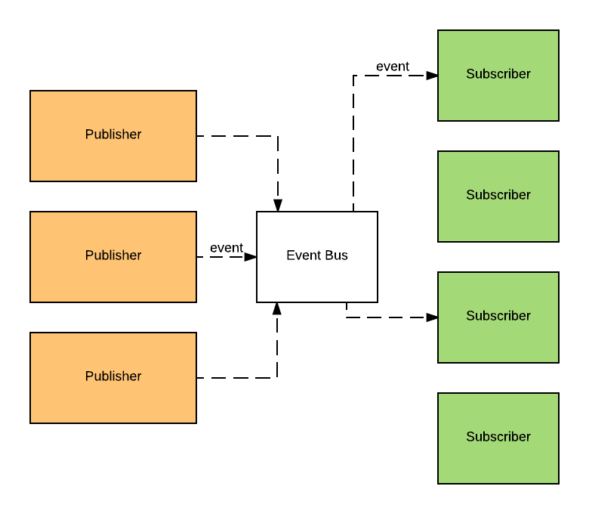
Publish-Subscribe Illustrated

Slide 17
Log Aggregation
Log aggregation collects physical log files off servers and put them in a central place such as a file server of HDFS for processing
Kafka abstracts away the details of files and gives a cleaner abstraction of log or event data as a stream of messages

Slide 18
Why Kafka?
Multiple Producers
Clients can use many topics or the same topic
Multiple Consumers
Multiple consumers can read any single stream of messages without interfering with each other
Some pub/sub systems only allow one consumer to read a message
Disk-based Retention
Messages are committed to disk and stored with configurable retention rules

Slide 19
Why Kafka?
Scalable
Flexible scalability was a design goal for Kafka from the beginning
Expansions can be performed while the cluster is online
Clusters can be configured with a replication factor
High Performance
Producers, consumers, and brokers can all be scaled to handle very large message streams
Sub-second message latency to consumers

Slide 20
What Kafka Does NOT Do
Not an end-user solution
You must write code for producers and consumers
Not a replacement for all features of a messaging systems
There are no individual queues controlling the consumption
No point-to-point messaging

Slide 21
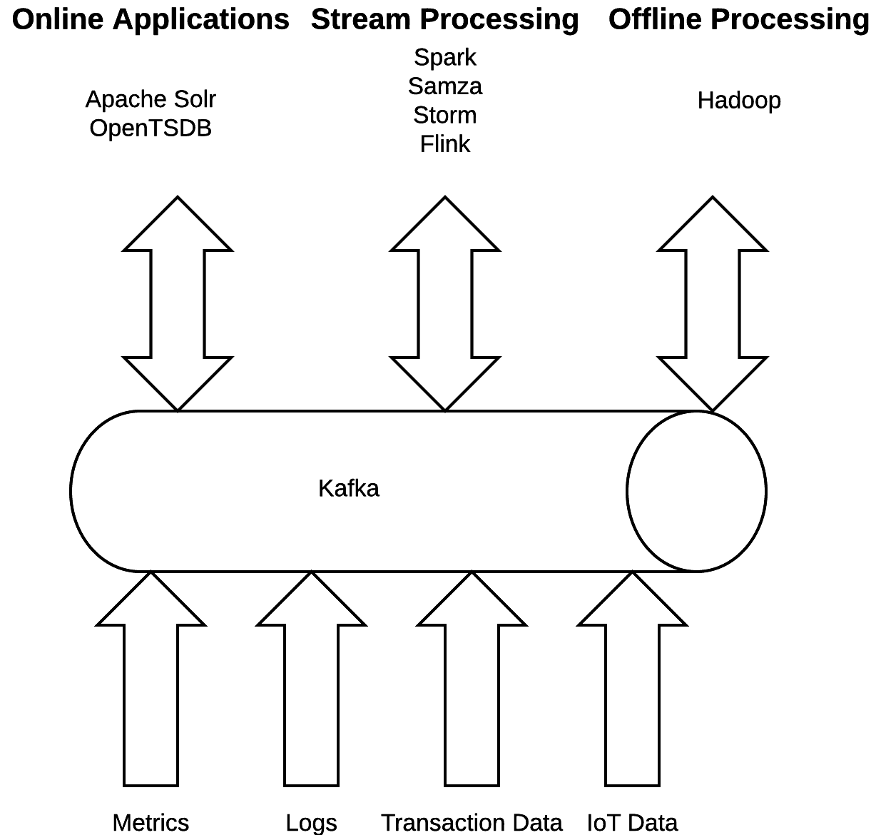
Kafka in the Big Data World

Slide 22
How Big is Big?
Here are some numbers from LinkedIn
Per day:
800 billion messages
175 TB of data
650 TB of consumed data
Per second:
13 million messages
2.75 GB of data
Configuration
1100 Kafka brokers
60 clusters

Slide 23
Kafka Main Concepts: Topics
Proucers
Kafka
Consumers
Topic A
Topic B

Slide 24
Kafka Main Concepts: Message
Kafka looks at every message as a sequence of bytes
The bytes are separated into:
Key
Used to determine partition (more about that later)
Value
The actual payload of the message

Slide 25
Kafka Key Concepts: Partitions
Topic
Partition 0
Partition 1
Partition 2

Slide 26
Kafka Key Concepts: Partitions vs. Topics
Partitions are to topics as lanes to roads
Difference, messages don’t change lanes…

Slide 27
Kafka Main Concepts: Broker
A server or process running Kafka
Holds multiple partitions across multiple topics
The physical manifestation of Kafka

Slide 28
Kafka Main Concepts: Clusters
Availability Zone
Availability Zone
Availability Zone

Slide 29
Kafka Main Concepts: Partitions and Clusters
Kafka Broker
Kafka Broker
Partition 0
Leader Partition 1
Replica Partition 1
Replica Partition 0
Replica Partition 2
Replica Partition 2
Kafka Broker
ZooKeeper
Leader Partition 2
Replica Partition 0
Replica Partition 1

Slide 30
Summary
Apache Kafka is an open source, distributed, partitioned, and replicated commit-log based publish-subscribe messaging system
Scalable
High Performance
Multiple Consumers
Multiple Producers
Disk-based Retention

Slide 31
Start of Exercise
Do you have Docker installed?
We will be using Docker to run Kafka
If you have not done so already, please install Docker
https://docs.docker.com/engine/installation/
Check if Docker works by running

Slide 32
Check installation of Docker
$ docker -v
Docker version 1.13.0, build 49bf474
$ docker run hello-world
Unable to find image 'hello-world:latest' locally
latest: Pulling from library/hello-world
78445dd45222: Already exists
Digest: sha256:c5515758d4c5e1e838e9cd307f6c6a0d620b5e07e6f927b07d05f6d12a1ac8d7
Status: Downloaded newer image for hello-world:latest
Hello from Docker!
This message shows that your installation appears to be working correctly.
To generate this message, Docker took the following steps:
1. The Docker client contacted the Docker daemon.
2. The Docker daemon pulled the "hello-world" image from the Docker Hub.
3. The Docker daemon created a new container from that image which runs the
executable that produces the output you are currently reading.
4. The Docker daemon streamed that output to the Docker client, which sent it
to your terminal.
To try something more ambitious, you can run an Ubuntu container with:
$ docker run -it ubuntu bash
Share images, automate workflows, and more with a free Docker ID:
https://cloud.docker.com/
For more examples and ideas, visit:
https://docs.docker.com/engine/userguide/

Slide 33
docker-compose.yml
version: '2'
services:
zookeeper:
image: wurstmeister/zookeeper:3.4.6
ports:
- 2181:2181
kafka:
image: wurstmeister/kafka:1.1.0
environment:
KAFKA_LISTENERS: PLAINTEXT://kafka:9092
KAFKA_ZOOKEEPER_CONNECT: zookeeper:2181
ports:
- 9092:9092
Run Zookeeper
Run Kafka

Slide 34
Essential Kafka CLI Commands (used in exercise)
Kafka can be configured via the command
Key commands
kafka-topics.sh
Allows us to manipulate and view topics
kafka-console-producer.sh
Allows us to produce data from using stdin
kafka-console-consumer.sh
Allows us to consume messages from the console
We're running all tools in docker, so we have to 'reach into' the docker instance, hence our commands look like this:
docker-compose exec kafka /opt/kafka/bin/CMD
You may want to alias these commands to reduce typing or simply run a bash shell inside the docker image
docker-compose exec kafka /bin/bash

Slide 35
Lab
In this lab we'll simply ensure that we can run Kafka
We'll run Kafka using Docker
Easy configuration
Runs Kafka and Zookeeper
Flexible setup that allows us to setup a cluster of machines for later exercises
The lab simply:
Starts the docker images using docker-compose
Runs a simple producer
Runs a simple consumer
Allows you to type messages in the producer and see them consumed by the consumer

Slide 36
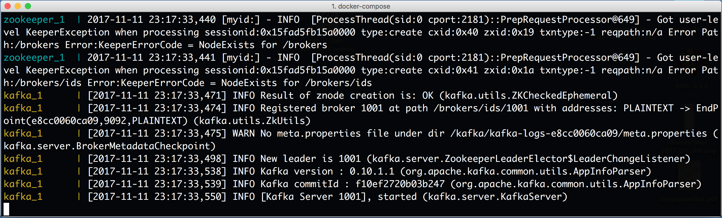
Step 1: Start Kafka and ZooKeeper
In a terminal, go to: kafka-labs/labs/01-Verify-Installation
Run: docker-compose up
www.scispike.com
36

Slide 37
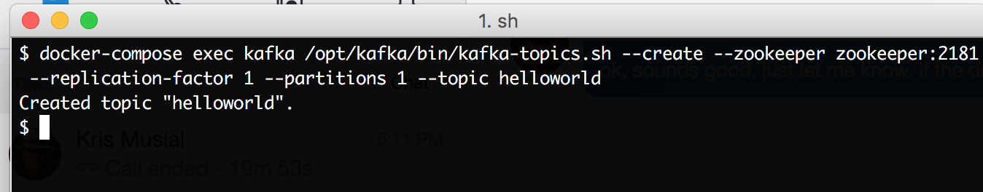
Step 2: Create a Topic
Run a second terminal and go to the directory kafka-labs/labs/01-Verify-Installation
In this directory run: docker-compose exec kafka /opt/kafka/bin/kafka-topics.sh --create --zookeeper zookeeper:2181 --replication-factor 1 --partitions 1 --topic helloworld
www.scispike.com
37

Slide 38
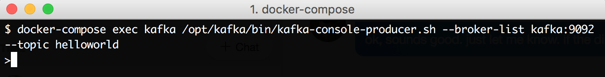
Step 3: Run the Kafka Producer
In the same terminal as you created the topic, in the directory: kafka-labs/labs/01-Verify-Installation
In this directory run: docker-compose exec kafka /opt/kafka/bin/kafka-console-producer.sh --broker-list kafka:9092 --topic helloworld

Slide 39
